Slide 1
City of Seattle Public Health: Chronic Conditions
By May Paddor

Slide 2
Background

Slide 3
Background: RSI Index
Measure | Diabetes | Asthma | Mental Health Not Good
Min | 1.2% | 8.0% | 7.1%
Mean | 6.84% | 8.93% | 9.97%
Max | 17.77% | 11.4% | 16.2%
- Racial and Social Equity Composite Index
- Obtained from data.gov
- Last updated in 2022
- Collected by the City of Seattle
- Looks at trends in race, socioeconomic status and health disadvantages in the different neighborhoods in Seattle by census tract

Slide 4
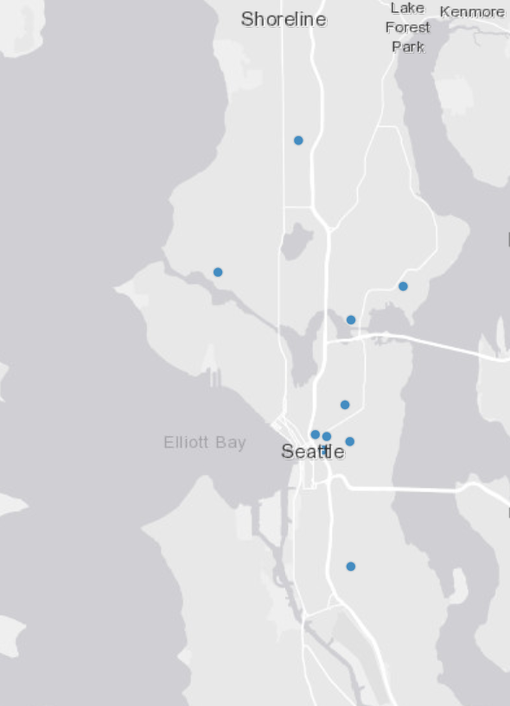
Background: Hospital Data
Hospital Data
Collected by Seattle’s GeoData website
Data updated constantly through a GIS system
Lists the locations of all the hospitals in the Seattle area
Used all data points of hospitals located in the city

Slide 5
Background: Insurance
- Insurance Data
- Obtained from the City of Seattle
- Part of Seattle’s research to reduce health disparities
- Asian populations had the lowest rates of uninsured people at 4.5%
-American Indian and Native Alaskan populations reported the highest average (%) of uninsured individuals at 19.31%
***Data was incomplete for Native Hawaiian & Pacific Islanders, as well as American Indians and Alaskan Natives

Slide 6
Data Analyses

Slide 7
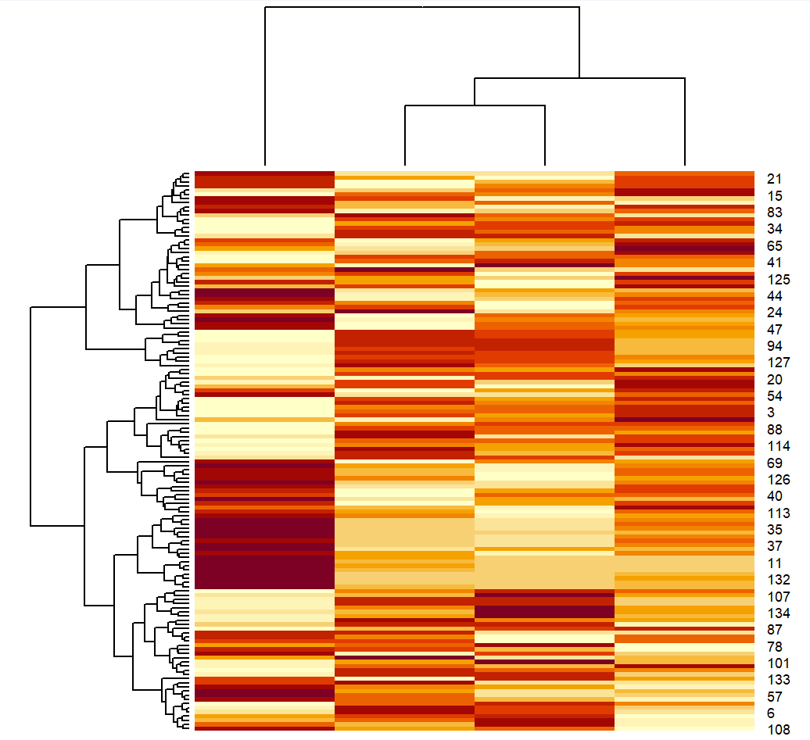
Cluster Analysis
- Heat Map = Correlations between data
- Diabetes seems inconsistent across most clusters
- Mental health and asthma look relatively correlated
- Health Percentile has the clearest gradient
Mental Health Not Good
Health
Percentile
Diabetes
Asthma

Slide 8
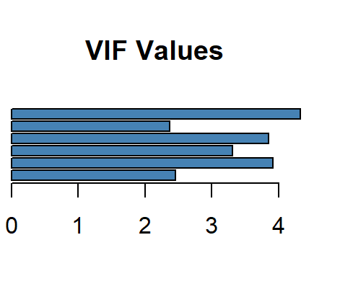
Multiple variable regression: Asthma
Variable | Asthma
Percent of Foreign Born | **
Percentile of Mental Health Not Good | ***
No Leisure/Physical Activity | -
Population in Poverty | -
Obesity | ***
Less than a Bachelor’s Degree | *
Adjusted R-Squared | 0.7596

Slide 9
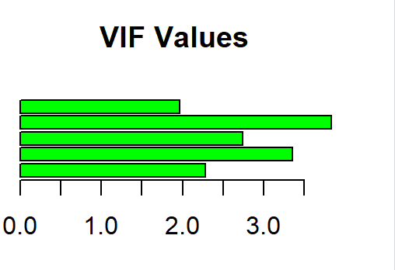
Multiple variable regression: Diabetes
Variable | Diabetes
Less than a Bachelor’s Degree | **
Percentile of Mental Health Not Good | ***
No Leisure/Physical Activity | ***
Population in Poverty | -
Obesity | ***
Adjusted R-Squared | 0.6785

Slide 10
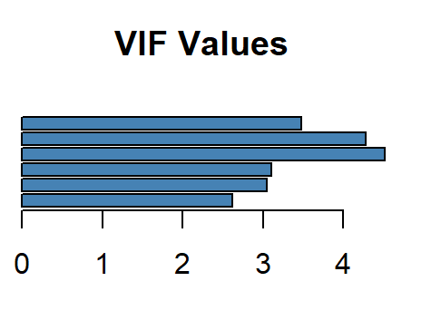
Multiple variable regression: Mental Health Not Good
Variable | Not Good Mental Health
Percent of Foreign Born | **
No Leisure/Physical Activity | ***
Percentile of Diagnosed Diabetes | *
Percentile of People with Asthma | ***
Population in Poverty | ***
Obesity | *
Adjusted R-squared | 0.9279

Slide 11
Chronic Conditions: Variable Observations
Variable | Asthma | Diabetes | Mental Health
Percent of Foreign Born | ** | - | **
No Leisure/Physical Activity | - | *** | ***
Percentile of Diagnosed Diabetes | NA | NA | *
Percentile of People with Asthma | NA | NA | ***
Population in Poverty | - | * | ***
Obesity | *** | *** | *
Mental Health Not Good | *** | ** | NA
Less than a Bachelor’s Degree | * | ** | NA

Slide 12

Chronic Condition Recommendations
Short-Term
Implement a public health campaign focusing on physical health
Long-Term
Incentivize companies to provide health and wellness stipends or courses to promote physical health

Slide 13
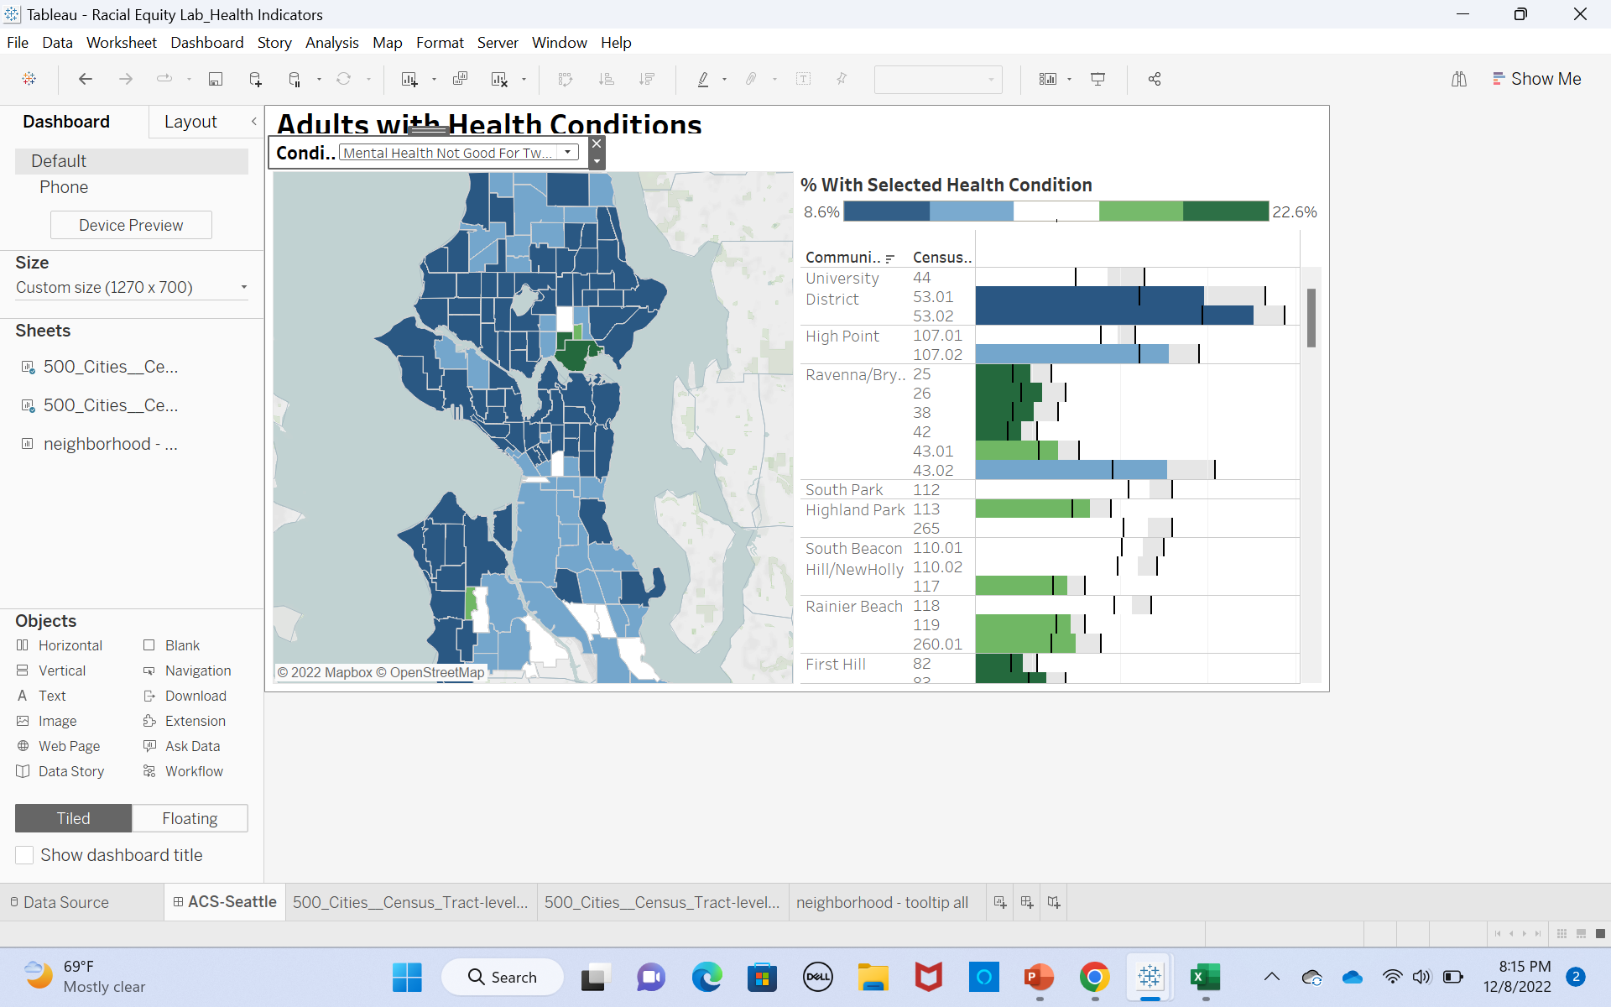
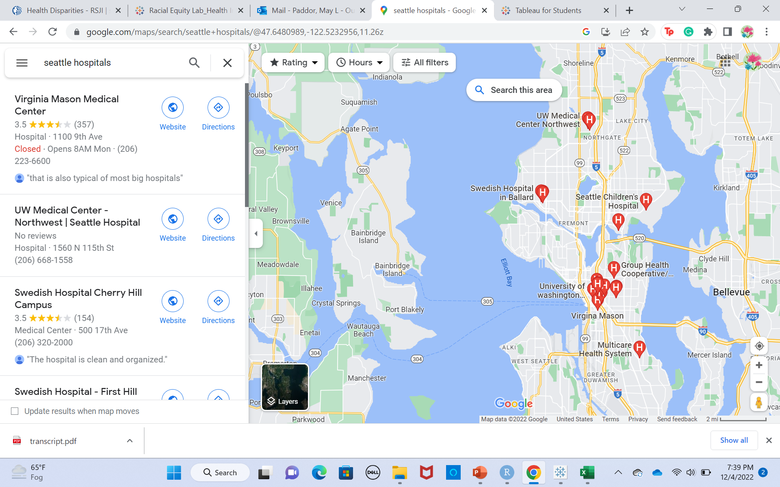
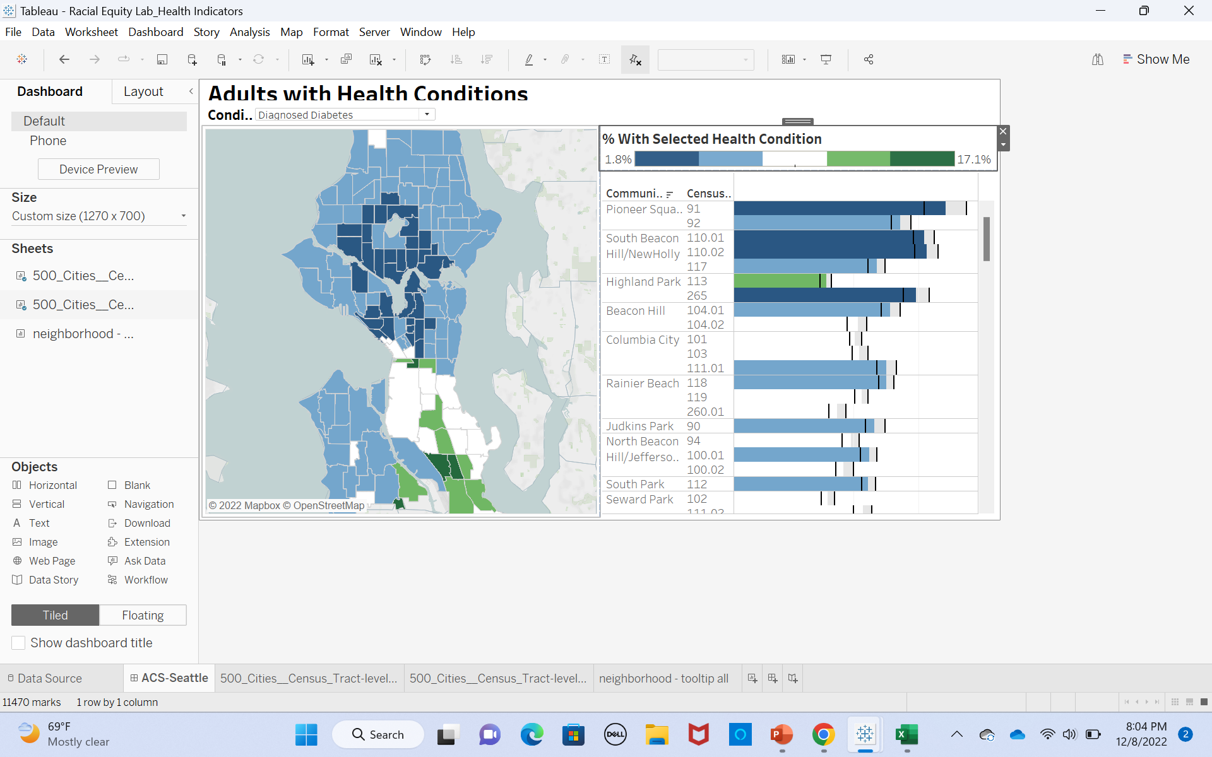
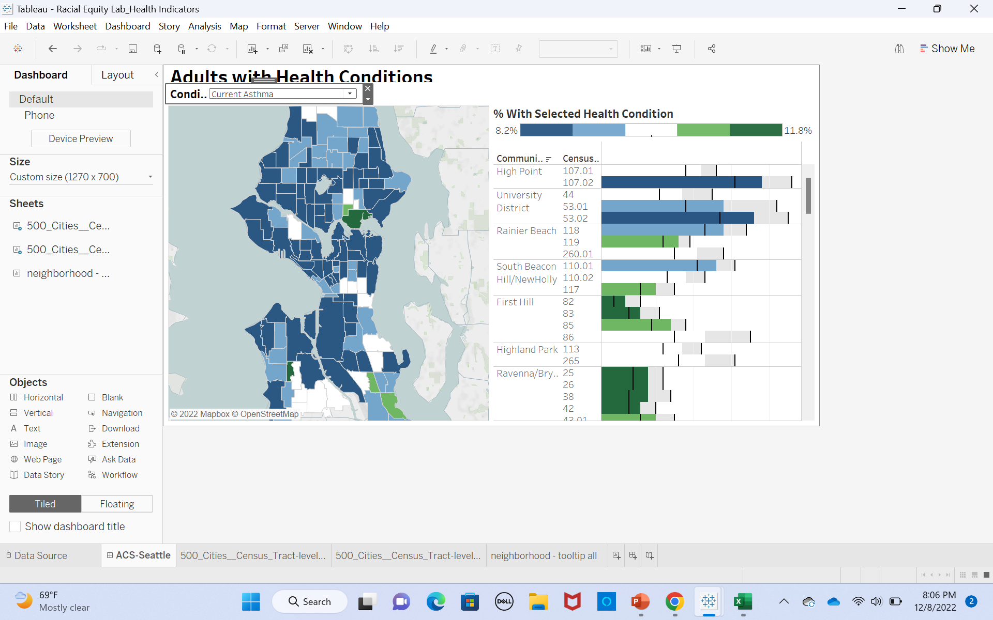

High Burden of Disease & Hospitals
low
high
Percentile of Diabetes
Percentile of Asthma
Percentile of Mental Health Not Good

Slide 14


Hospital Data Recommendations
Short term
01
Conduct research on the community’s hospital care needs
Review the performance of caregivers in high-burden areas
Long Term
02
Invest in healthcare providers in high burden areas
Create a program with nonprofits like Project Access Northwest to streamline care coordination

Slide 15
High Burden & People Without Insurance

Slide 16

Insurance Recommendations
Short
- Connect with community leaders to help educate community members on health insurance and enrollment
- Research the barriers to care for minority communities
Long
- Invest a long-term program to provide support to people seeking to enroll in healthcare

Slide 17

Thank you for Listening! Questions?

